Slide 1
ENCHANTED EDEN
(ONLINE PLANT NURSERY AND MONITORING SYSTEM)
Prepared By:
Amalda Patrick
Roll No: 2011

Slide 2
Project Overview
Enchanted Eden is a plant nursery web application designed for plant enthusiasts to explore and purchase a variety of plants. The platform allows Guest Users to browse products, filter based on plant care needs, and view general information. Registered Users can create accounts to enjoy ordering features and view order statuses. The Administrative Staff manage the inventory, update product listings, and ensure smooth operation of the platform.

Slide 3
USERS
The Enchanted Eden includes three main user types, each with specific roles and functionalities:
Admin:
This user type oversees the entire platform, focusing on high-level monitoring and management. Key features include:
Manage product inventory: add, update, and remove items.
Manage Users
Manage reports on sales.
Update and monitor the status of orders.

Slide 4
2. Guest User: A guest user accesses services without a registered account or login. The functionalities include:
Browse products across categories.
View general product information.
Filter products by sunlight, water needs, climate, and more.
Login.

Slide 5
3. Customers: This user role focuses on purchasing products and viewing order statuses, emphasizing customer interaction
Create accounts to access personalized features.
View styles of cultivation.
Purchase plants and view order details.

Slide 6
TECHNOLOGIES USED
Django
Database - PostgreSQL
Front End Back End
HTML
CSS
JavaScript
Bootstrap

Slide 7
System Study EXISTING SYSTEM
Limited Accessibility: Traditional nurseries operate from physical stores, making it difficult for distant customers to access a wide variety of plants.
Restricted Variety: Due to space constraints, nurseries can only display a limited selection of plants, making it hard to find rare or specific species.
Inconvenience & Time: Visiting in person is inconvenient for customers with busy schedules or mobility challenges, and searching for specific plants is often inefficient.
Manual Operations: Handling sales, inventory, and admin tasks manually is inefficient and slow.
Lack of Personalization: There are no features like delivery tracking or customer preference analysis to improve service.

Slide 8
System Study PROPOSED SYSTEM
Wider Accessibility: The online platform allows customers to browse and purchase plants from anywhere, removing geographical restrictions and reaching a larger audience.
Expanded Variety: The system can showcase an extensive selection of plants, including rare or specialty species, without space limitations.
Convenient Shopping Experience: Users can easily search for and filter plants based on their needs (sunlight, water, climate) without visiting a physical store, saving time and effort.
Efficient Management: Admins can keep the product list updated and relevant.
Real-Time Updates: Order and delivery tracking keep customers informed.
Competitive Edge: By moving online, nurseries can compete effectively with online retailers, offering a wider selection, better customer service, and modern features.

Slide 9
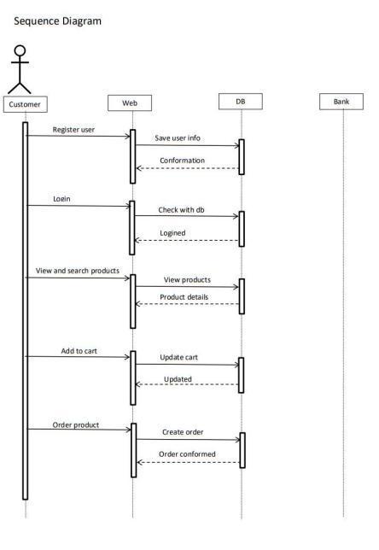
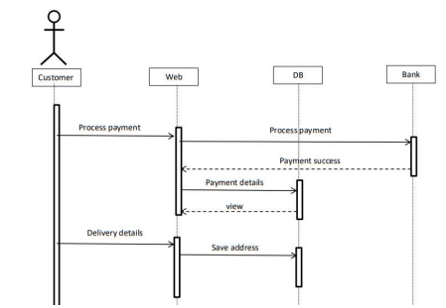
System Flow

Slide 10
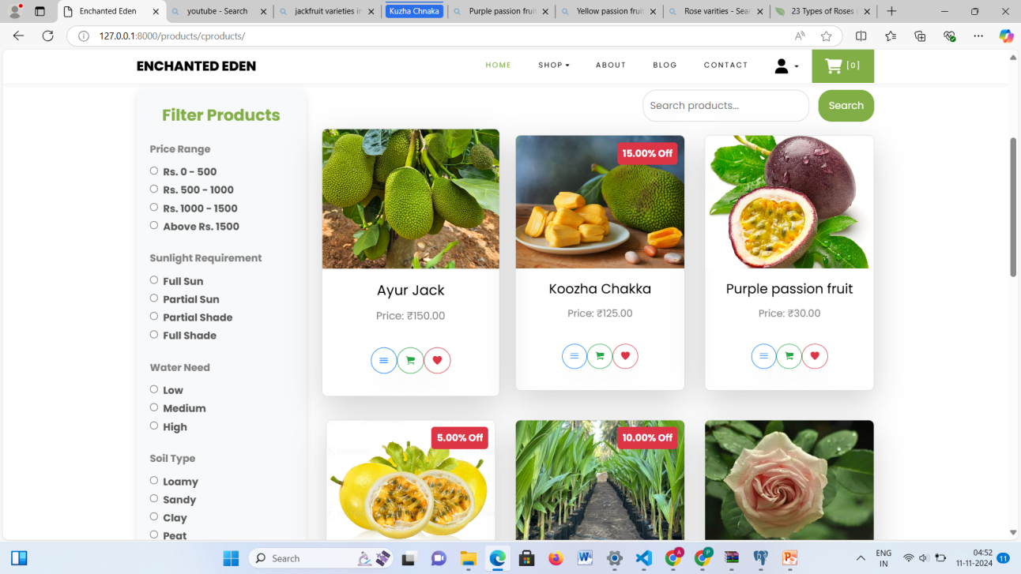
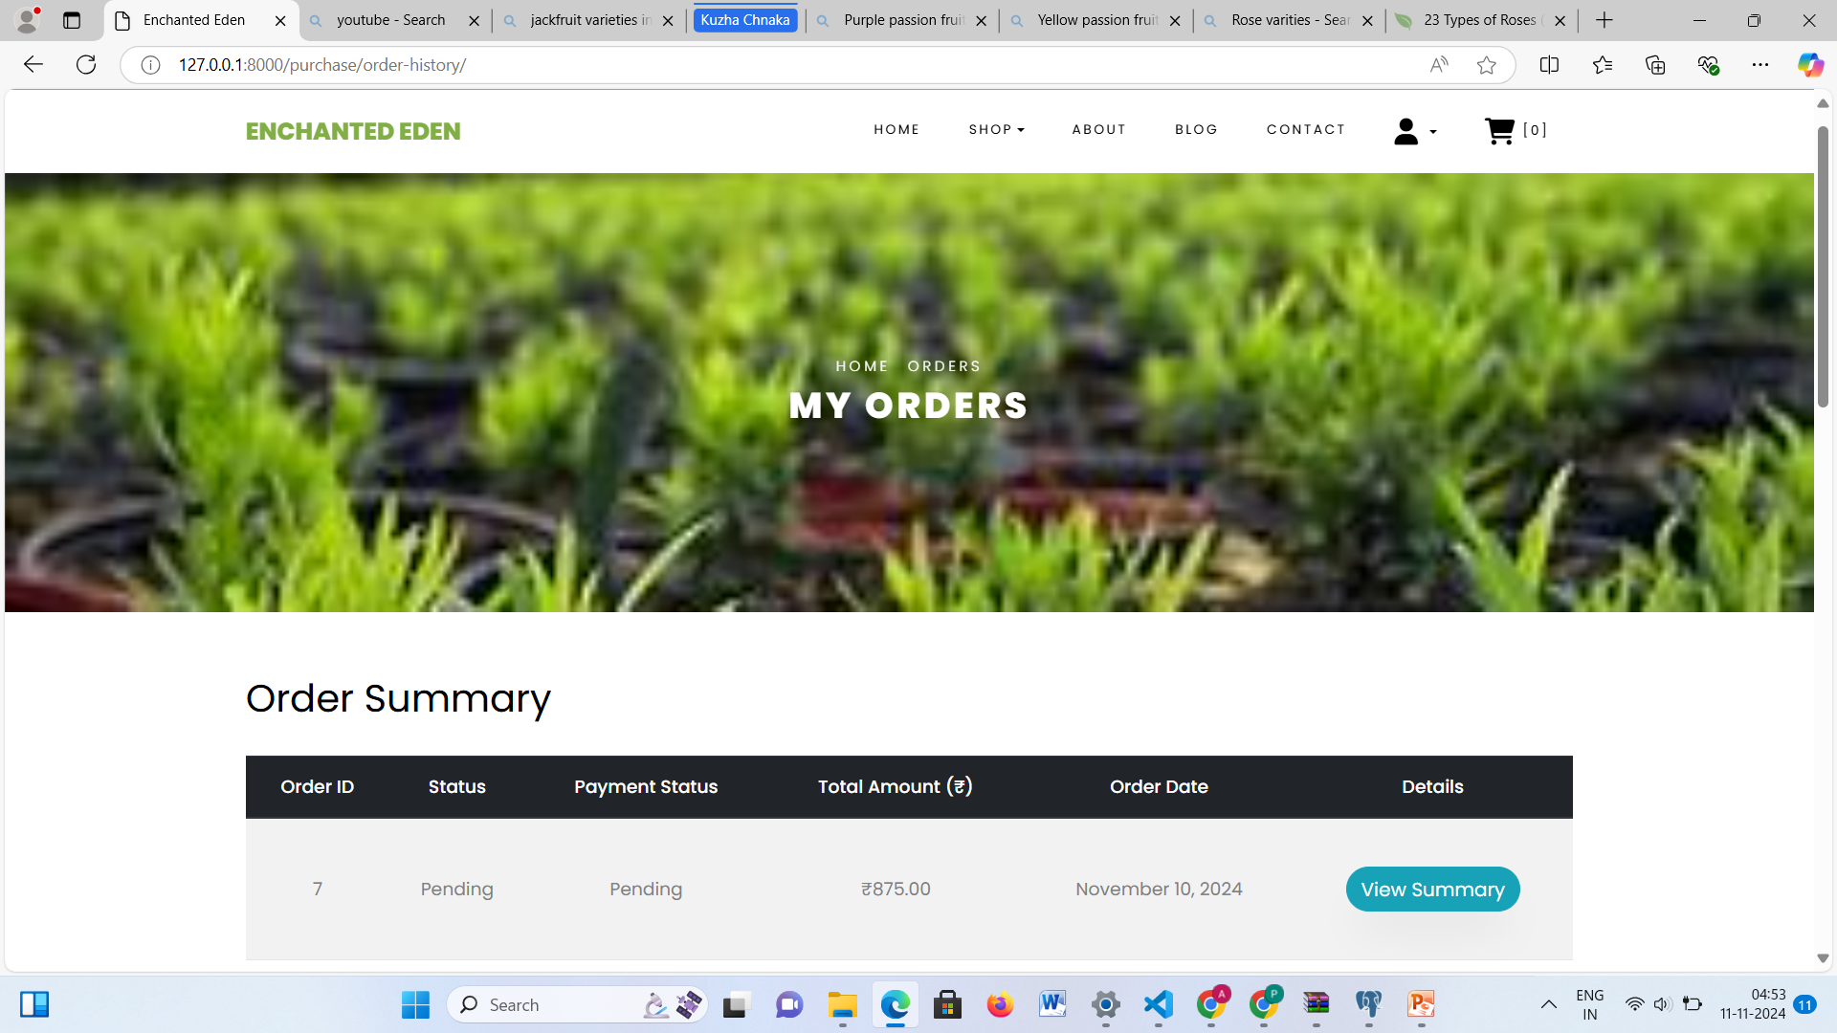
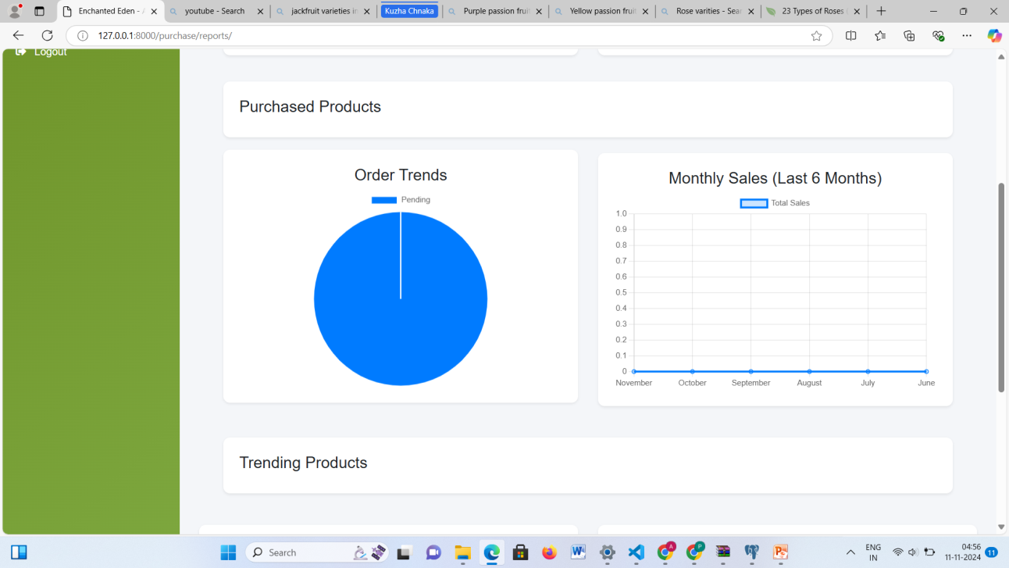
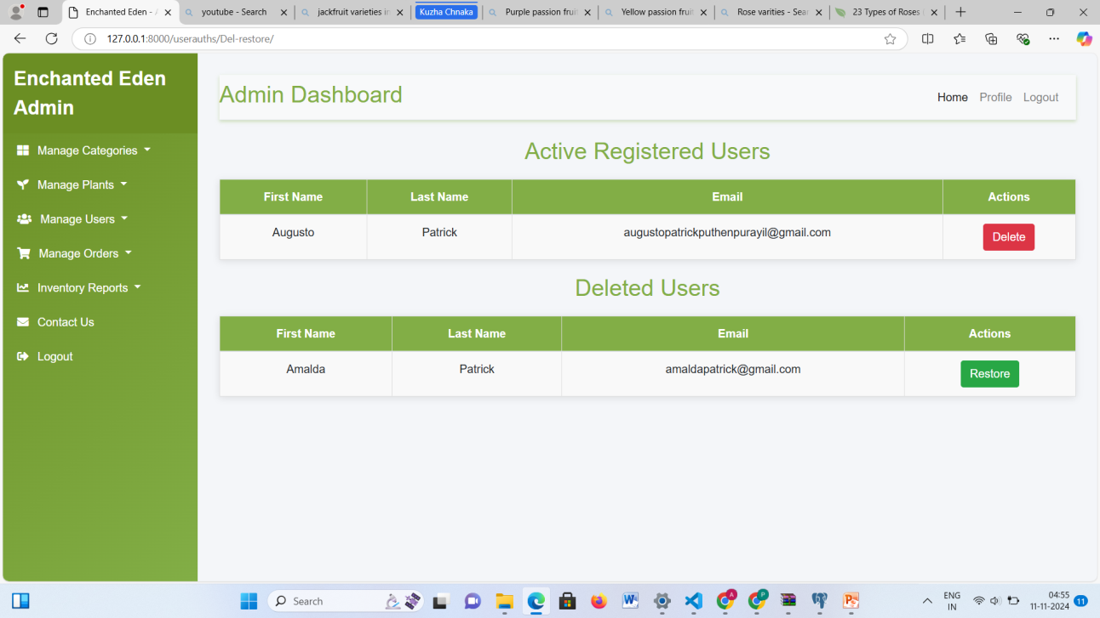

Slide 11
Conclusion and Future Scope Conclusion
The Enchanted Eden Plant Nursery Management System is an interactive online platform that enhances plant shopping and care guidance. Users can explore a wide range of plants, filter based on preferences like sunlight and water needs, and enjoy personalized features such as cart management and order tracking. Administrators have powerful tools for managing inventory, updating product details, and generating sales reports, ensuring efficient operations and excellent customer service. Enchanted Eden streamlines plant shopping and nursery management, creating a seamless experience for both customers and administrators.

Slide 12
Conclusion and Future Scope Future Scope
Enchanted Eden can be enhanced with features that boost user engagement and interaction. Registered users can share monthly plant reviews with photos, even for plants not bought on the platform, and receive personalized feedback. Machine learning could enable interactive Q&A sessions for expert plant care advice. Users could request planting assistance from skilled workers for specific needs, and product reviews would help others make informed decisions. Educational content from plant care specialists could further enrich the platform. Delivery personnel would also provide real-time updates on orders, ensuring a smooth experience for customers. These features would make Enchanted Eden a more engaging and comprehensive platform.

Slide 13
Thank You…

